Slide 1
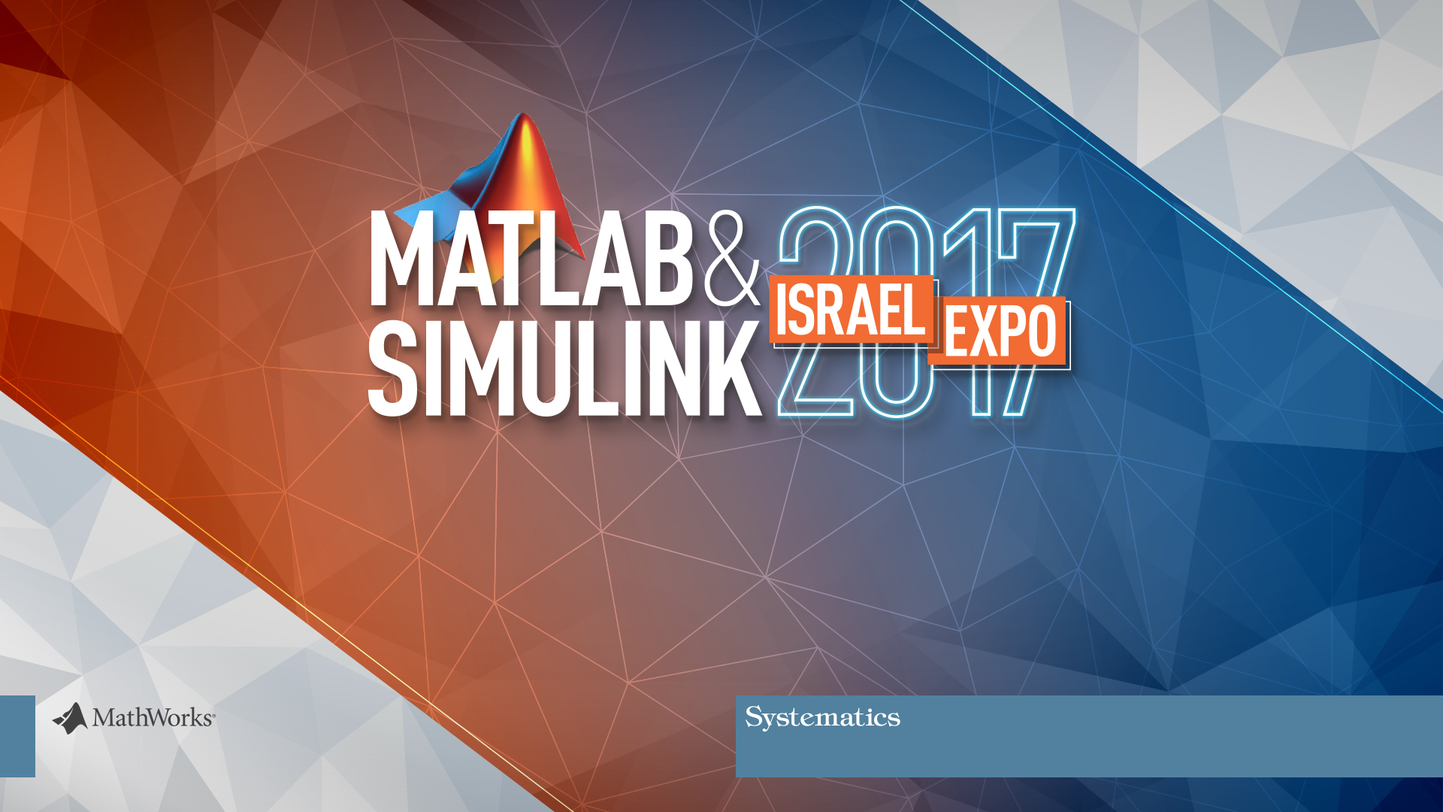
MATLAB for Data Analytics

Slide 2


Agenda for Today
Data Analytics
MATLAB for Data Analytics
Tackling Big Data with MATLAB
Anagog - From Mobility Status to Dynamic Mapping
MATLAB and the IoT (Internet of Things)
Machine Learning for Sensor Data Analytics
Notes:
בהרצאה הראשונה נסקור את השלבים השונים בתהליך ה- data analytics נדבר על האתגרים השונים בתהליך ונכיר גישות וטכניקות ב-MATLAB כדי להתמודד איתם
לאחר מכן נראה כיצד להתמודד עם מידע שאינו מתאים לגודל הזיכרון.
לאחר מכן אורי חי מחברת אנאגוג יספר לנו על החברה ופתרון מבוסס ענן שהיא מציעה.
לאחר מכן ובהמשך מתבקש להרצאה של אורי, נרחיב את הדיבור על יכולות IOT ולמידת מכונה במטלב
Anagog’s powerful system architecture provides in-device mobility status detection, with cloud-based processing power, deep learning and an insightful analytics platform.
Our SDK uses multiple smartphone sensors to anonymously detect the mobility status and understand the activity context of users. By combining our technology and machine learning, our SDK can help you understand the precise activity level, context and location of your users.

Slide 3
MATLAB for Data Analytics
Shiran Golan
Application Engineer
shirang@systematics.co.il
Notes:
לפתוח קובץ אקסל 2016 לדוגמא ולהפוך תחת page layout את הכיוון להיות left to right
לפתוח ולהריץ סקריפטים:
C:\Users\shirang\Documents\חומר לסמינרים\Expo2017\WeatherEventAnalysis\WeatherEventAnalysis\StormEvents1.mlx
C:\Users\shirang\Documents\חומר לסמינרים\Expo2017\WeatherEventAnalysis\WeatherEventAnalysis\StormEvents2.mlx
לפתוח לשוניות של Thinkspeak
להריץ אפליקציה של Human activity

Slide 4
Outline
Data Analytics Overview
Data Analytics Workflow
Example: Analyze Storm Events
Key Takeaways
Notes:
בהרצאה זו נסקור את השלבים השונים בתהליך ה- data analytics ונכיר גישות וטכניקות ב-MATLAB כדי להתמודד עם האתגרים השונים בתהליך.
נראה כיצד ניתן לגשת, לחקור ולנתח מידע המגיע ממקורות שונים, לבצע עיבוד מקדים למידע ולהציגו באופן ויזואלי, ולאחר מכן לבנות מודלים ולקבל תובנות מהמידע.

Slide 5
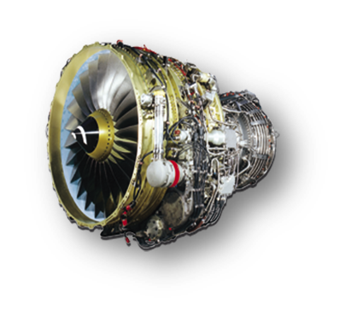


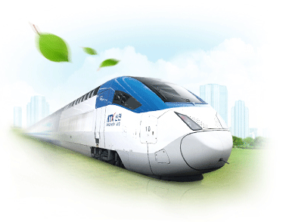

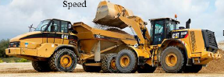


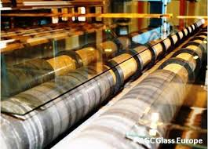
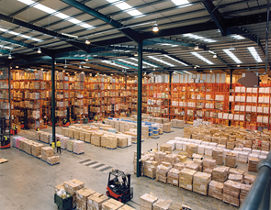

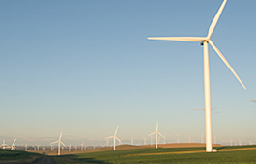
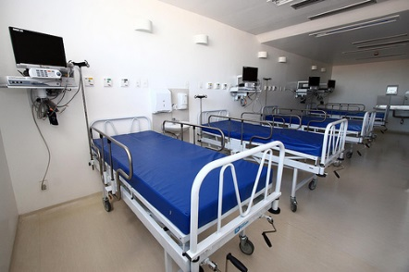

Automotive
Aeronautics
Retail
Railway Systems
Finance
Off-highway
vehicles
Condition
Monitoring
Prognostics
Retail Analytics
Internet
Fleet Analytics
Operational Analytics
Data
Analytics
Industrial Automation
Process Analytics
Risk Analysis
Health Monitoring
Supply Chain
Logistics
Mfg Process Analytics
Asset Analytics
Healthcare Analytics
Oil & Gas
Healthcare Management
Clean Energy
Medical Devices

Slide 6
What is Data Analytics?
Turn large volumes of complex data into actionable information
Descriptive
What happened?
Diagnostics
Why did it happen?
Predictive
What will happen?
Prescriptive
What should be done?
Data
Decisions

Slide 7

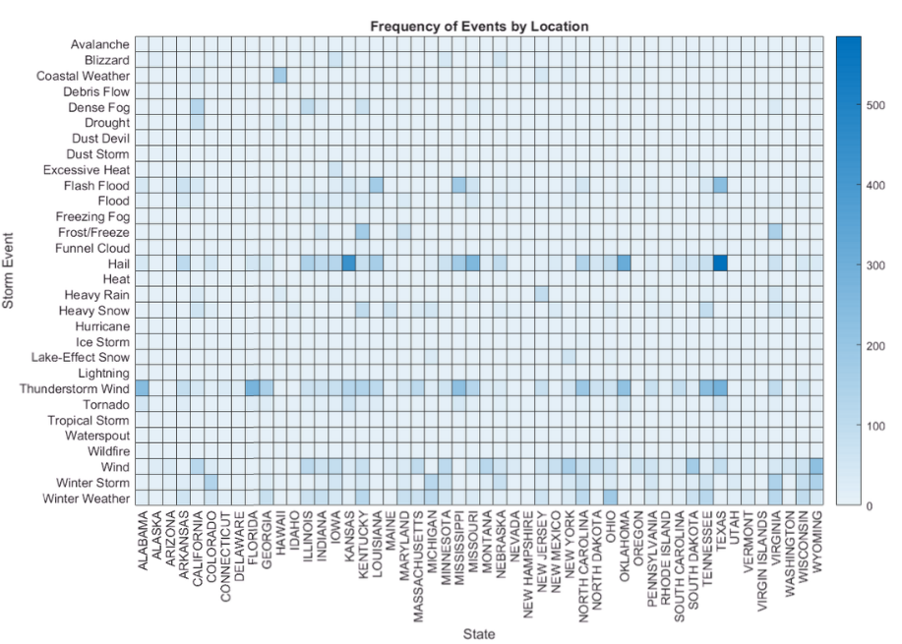
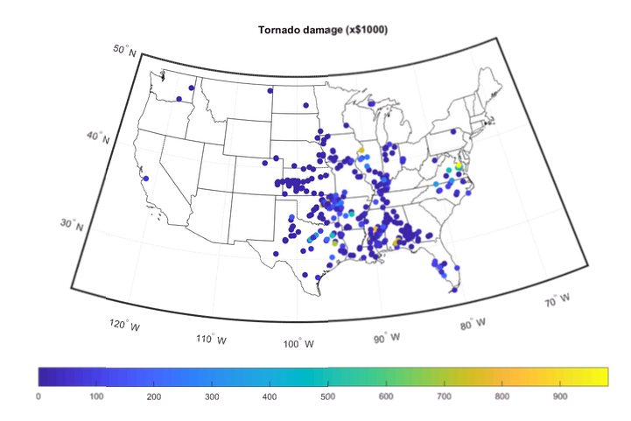
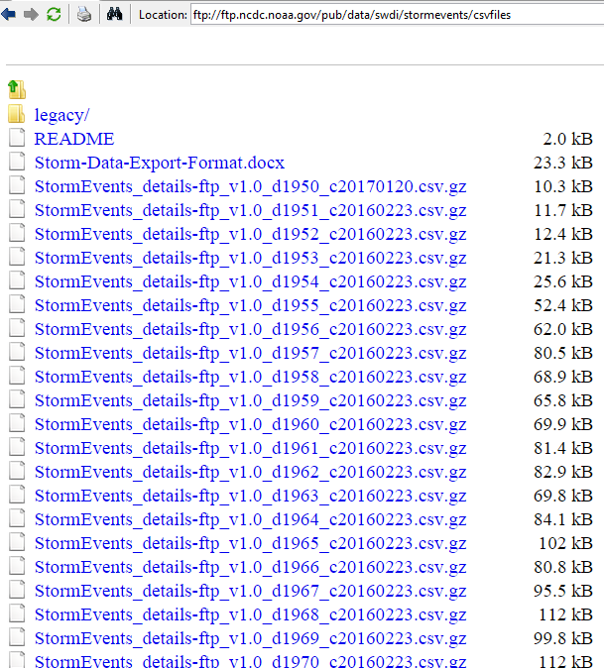
Example: Analyze Storm Events
- What is the frequency and damage costs of different
events types?
- Which events caused biggest damage?
- What is the probability for different events in the future?
ftp://ftp.ncdc.noaa.gov/pub/data/swdi/stormevents/csvfiles/
Notes:
Visualize frequency and damage costs by type and location.
Explore the connections between weather events.
Visualize storm event information on a map.

Slide 8

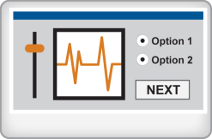
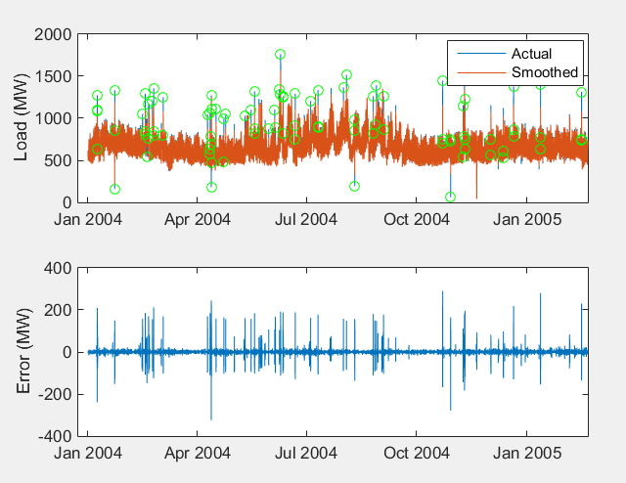
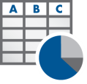

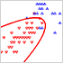
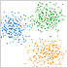
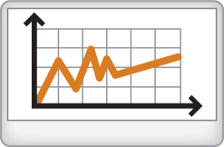
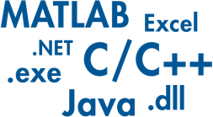

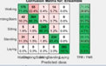










Data Analytics Workflow
Access and Explore Data
Preprocess Data
Develop Predictive Models
Integrate Analytics with Systems
Files
Working with
Messy Data
Model Creation e.g. Machine Learning
Desktop Apps
Databases
Data Reduction/
Transformation
Parameter Optimization
Enterprise Scale Systems
1
Sensors
Feature
Extraction
Model
Validation
Embedded Devices and Hardware

Slide 9
Data Analytics Workflow
Access and Explore Data
Preprocess Data
Files
Business and Transactional Data
Working with
Messy Data
Repositories – SQL, NoSQL, etc.
File I/O – Text, Spreadsheet, etc.
Web Sources – RESTful, JSON, etc.
Databases
Data Reduction/
Transformation
Engineering, Scientific and Field Data
Real-Time Sources – Sensors, GPS, etc.
File I/O – Image, Audio, etc.
Communication Protocols – OPC (OLE for Process Control), CAN (Controller Area Network), etc.
Sensors
Feature
Extraction

Slide 10

Data Analytics Workflow
Access and Explore Data
Challenges
Preprocess Data
Data aggregation
Different sources (files, web, etc.)
Different types (images, text, audio, etc.)
Data clean up
Poorly formatted files
Irregularly sampled data
Redundant data, outliers, missing data etc.
Domain specific processing
Signals: Smoothing, resampling, denoising, Wavelet transforms, etc.
Images: Image registration, morphological filtering, deblurring, etc.
Dealing with out of memory data (big data)
Files
Working with
Messy Data
Databases
Data Reduction/
Transformation
Sensors
Feature
Extraction

Slide 11
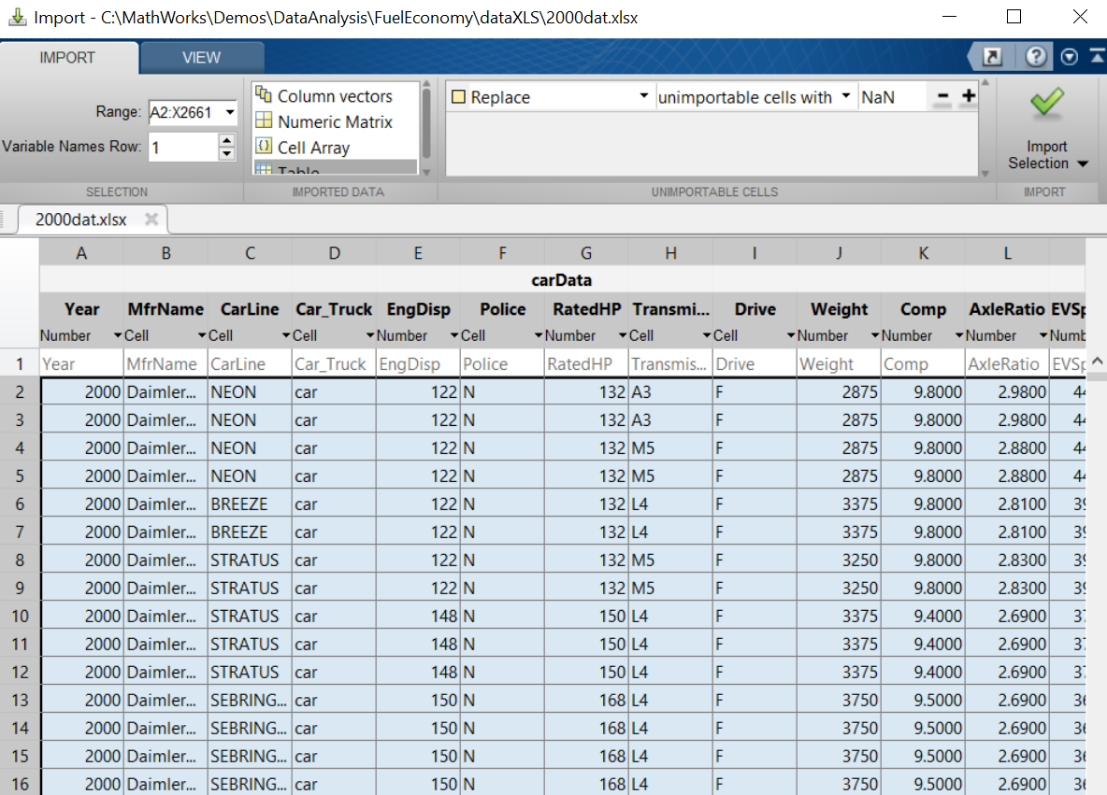
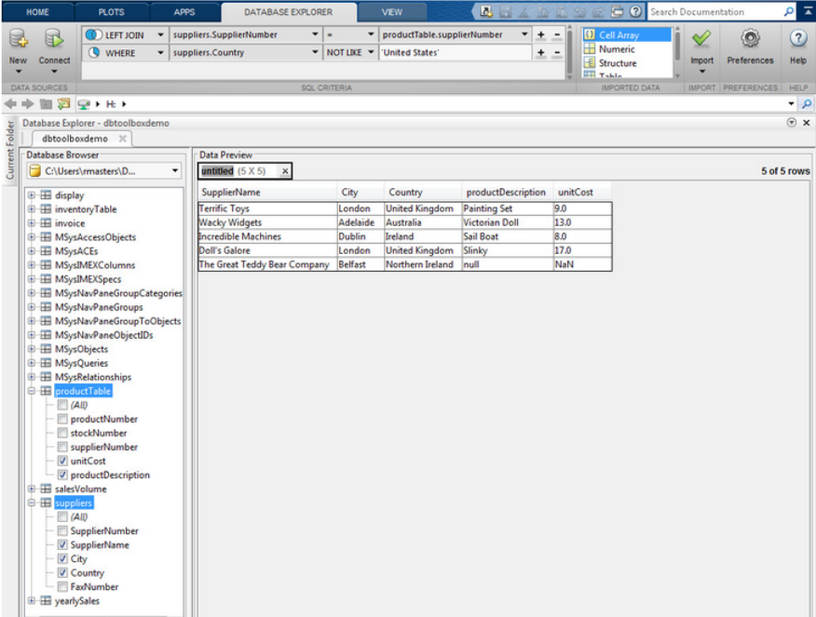
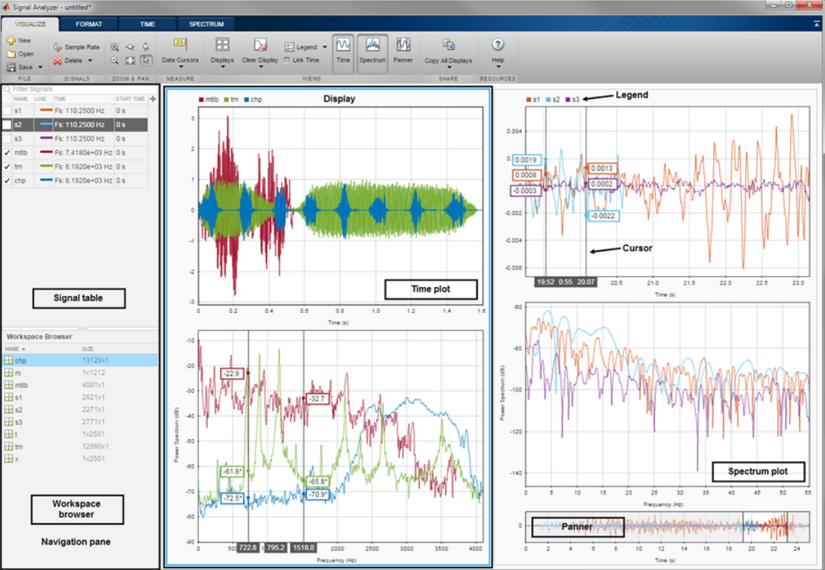
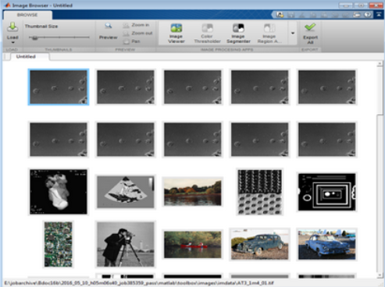
Data Analytics Workflow
1
MATLAB Analytics work with business and engineering data
Access and Explore Data
Preprocess Data
Files
Working with
Messy Data
Databases
Data Reduction/
Transformation
Files
Databases
Signals
Images
Sensors
Point and click tools to access variety of data sources
Automatic code generation
Built-in algorithms for data preprocessing including sensor, image, audio, video and other real-time data
Feature
Extraction

Slide 12
Data Analytics Workflow
Access and Explore Data
Preprocess Data
Develop Predictive Models
Integrate Analytics with Systems
Files
Working with
Messy Data
Model Creation e.g. Machine Learning
Desktop Apps
Databases
Data Reduction/
Transformation
Parameter Optimization
Enterprise Scale Systems
1
2
Sensors
Feature
Extraction
Model
Validation
Embedded Devices and Hardware

Slide 13
Data Analytics Workflow
Preprocess Data
Develop Predictive Models
Challenges
Lack of data science expertise
Feature Extraction – How to transform data to best represent the system?
No right way of designing features
Feature Selection – What attributes or subset of data to use?
Trial and error
Difficult to evaluate features
Model Development
Many different models
Model Validation and Tuning
Time required to conduct the analysis
Working with
Messy Data
Model Creation e.g. Machine Learning
Data Reduction/
Transformation
Parameter Optimization
Feature
Extraction
Model
Validation

Slide 14
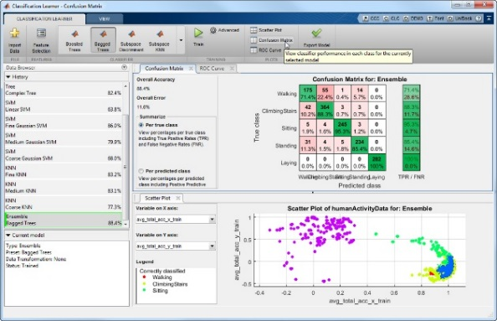
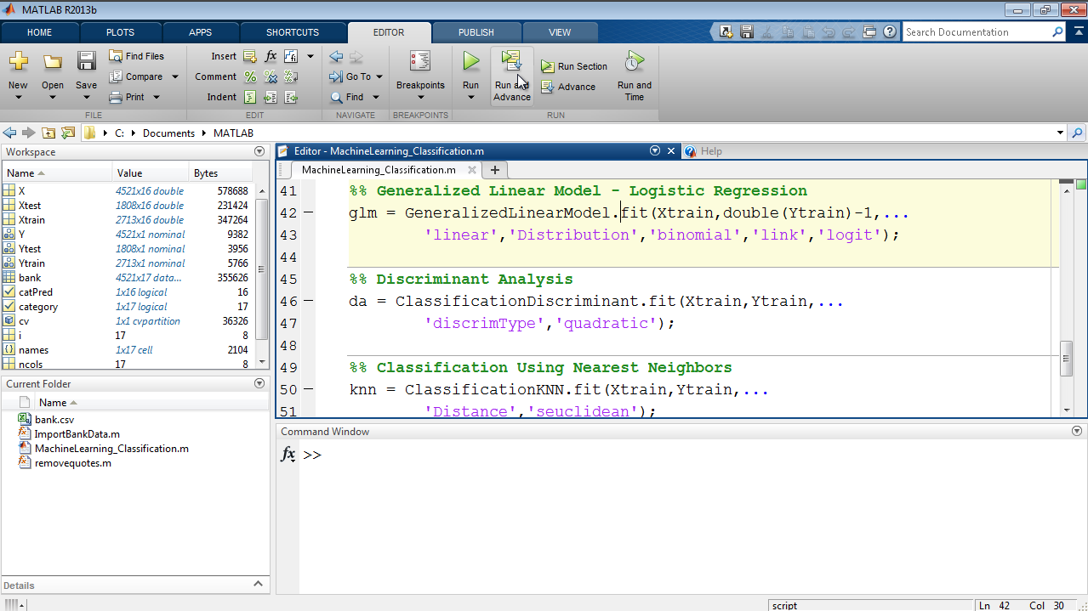

Data Analytics Workflow
2
Preprocess Data
MATLAB enables domain experts to do Data Science
Develop Predictive Models
Working with
Messy Data
Apps
Language
Model Creation e.g. Machine Learning
Data Reduction/
Transformation
Parameter Optimization
Wide breadth of tools to facilitate domain specific analysis
High speed processing of large data sets (parallel and GPU support)
Easy to use apps
Examples and videos
Automatic MATLAB code generation
Feature
Extraction
Model
Validation

Slide 15
Data Analytics Workflow
Access and Explore Data
Preprocess Data
Develop Predictive Models
Integrate Analytics with Systems
Files
Working with
Messy Data
Model Creation e.g. Machine Learning
Desktop Apps
Databases
Data Reduction/
Transformation
Parameter Optimization
Enterprise Scale Systems
1
2
3
Sensors
Feature
Extraction
Model
Validation
Embedded Devices and Hardware

Slide 16
Data Analytics Workflow
Develop Predictive Models
Integrate Analytics with Systems
Challenges
Model Creation e.g. Machine Learning
End user: Operators, Analysts, Administrative Staff, customers etc.
Different target platforms:
Cluster or Cloud environment
Standalone desktop applications
Server based Web and enterprise systems
Embedded hardware
Different Interfaces: C++, Java, .NET, Python, etc.
Need to translate analytics to production environment
Desktop Apps
Parameter Optimization
Enterprise Scale Systems
Model
Validation
Embedded Devices and Hardware

Slide 17
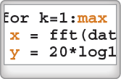
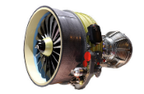

Integrate Analytics with Systems
3
MATLAB Analytics
run anywhere
Embedded Hardware
Enterprise Systems
C, C++
HDL
PLC
Standalone
Application
Excel
Add-in
Hadoop/
Spark
C/C++
Java
++
Python
.NET
MATLAB
Production
Server
MATLAB
Runtime
Notes:
אין מגבלת רישיון
רק להוריד בחינם את הMCR

Slide 18
Key Takeaways
1. Data Analytics Workflow
2. Data Analytics Challenges
3. MATLAB for Data Analytics
1
2
3
MATLAB Analytics work with business and engineering data
MATLAB enables
domain experts to do
Data Science
MATLAB Analytics
run anywhere

Slide 19
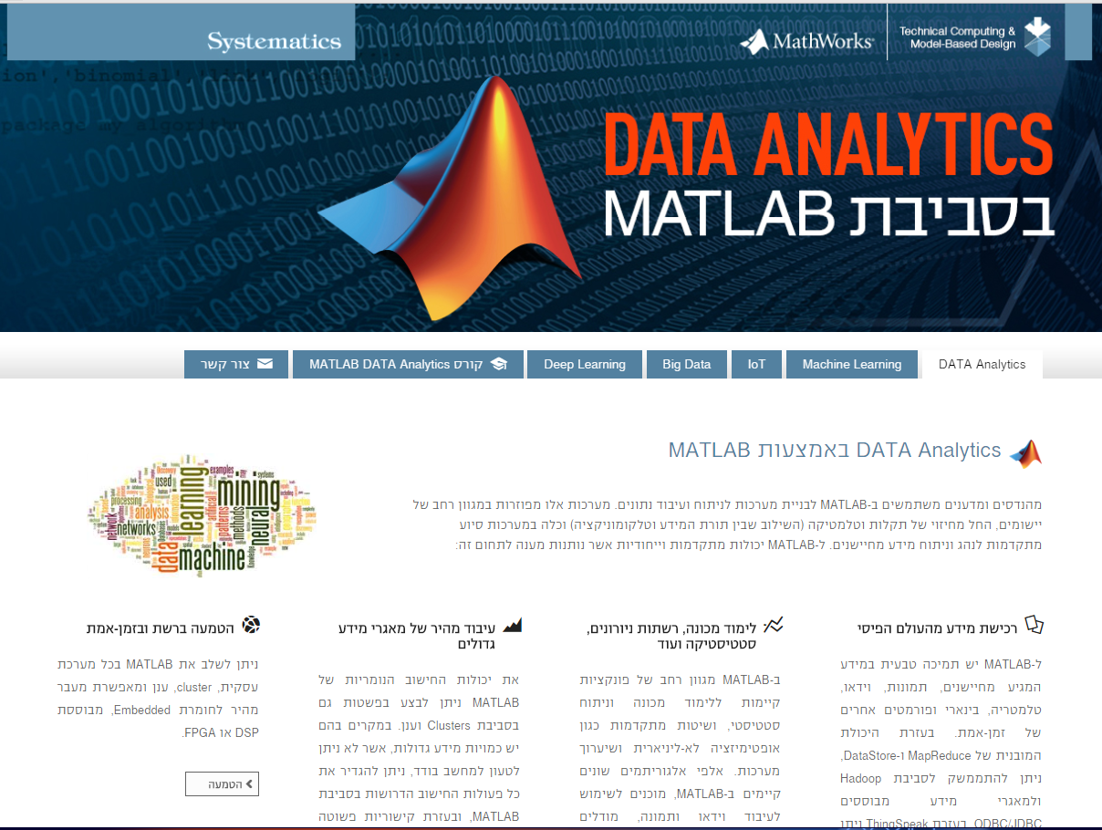
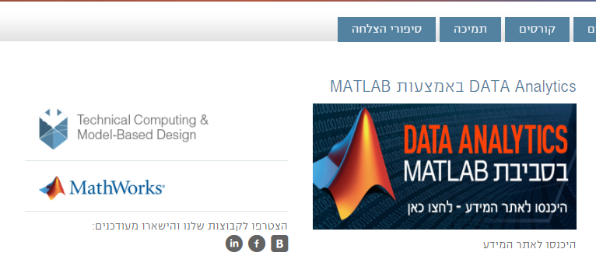
Further Information
https://www.systematics.co.il/products/mathworks

Slide 20
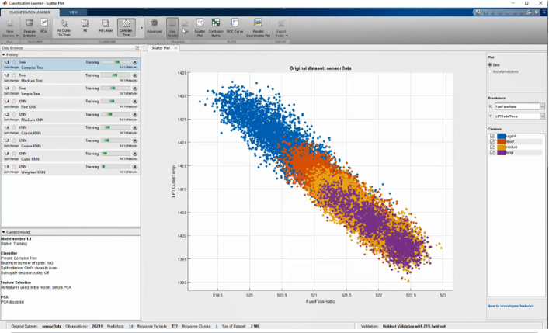
Data Analytics Training
MATLAB Programming Techniques
17+19 לספטמבר 2017
MATLAB Fundamentals
12+19+26 ליוני 2017
לפרטים נוספים:
בר נגר
03-7660129
Bars@systematics.co.il
Machine Learning
with MATLAB
2+9 ליולי 2017

Slide 21
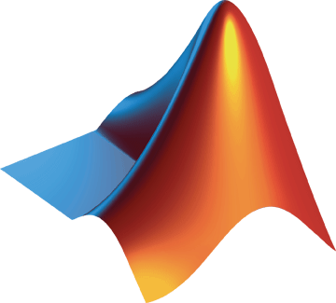
Thank You!

Slide 22
MATLAB for Data Analytics
Shiran Golan

Slide 23
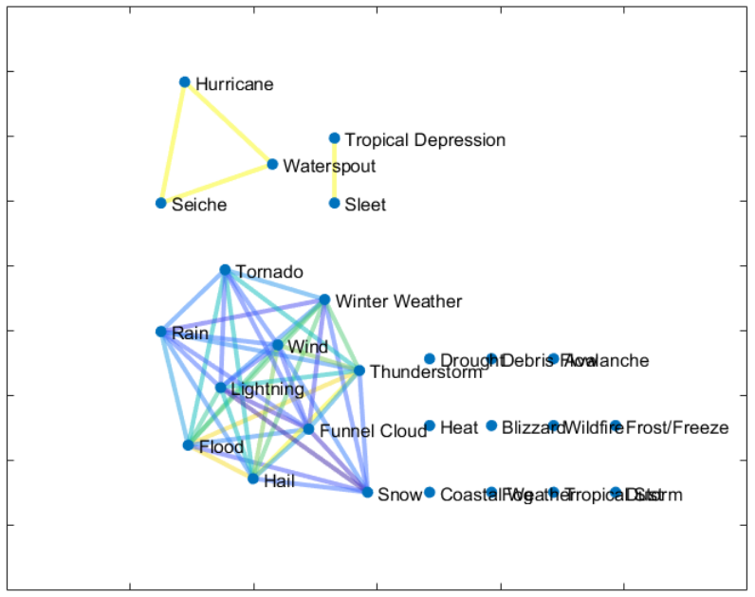
Example: Analyze Storm Events
Explore the connections between weather events.
Visualize frequency and damage costs by type and location.
Visualize storm event information on a map.
ftp://ftp.ncdc.noaa.gov/pub/data/swdi/stormevents/csvfiles/
Notes:
Visualize frequency and damage costs by type and location.
Explore the connections between weather events.
Visualize storm event information on a map.

Slide 24
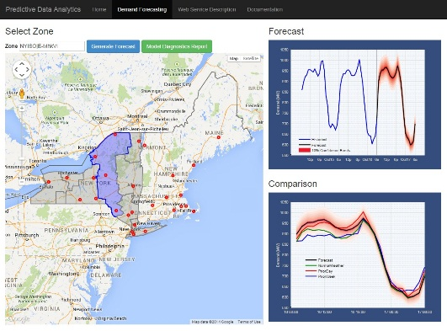

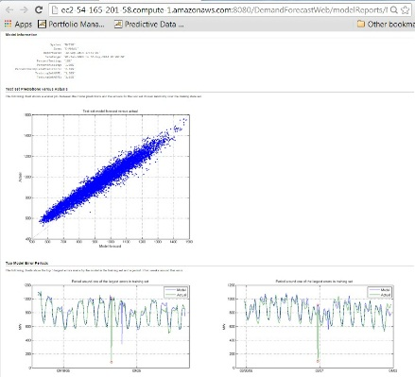

Deployed Analytics MATLAB Production Server
Web
Application Server
MATLAB
Production Server
MATLAB
Desktop
Train in MATLAB
Apache Tomcat
Web Server/
Webservice
MATLAB Production Server
Request Broker
Predictive Models
Weather Data
CTF
Energy Data

Slide 25
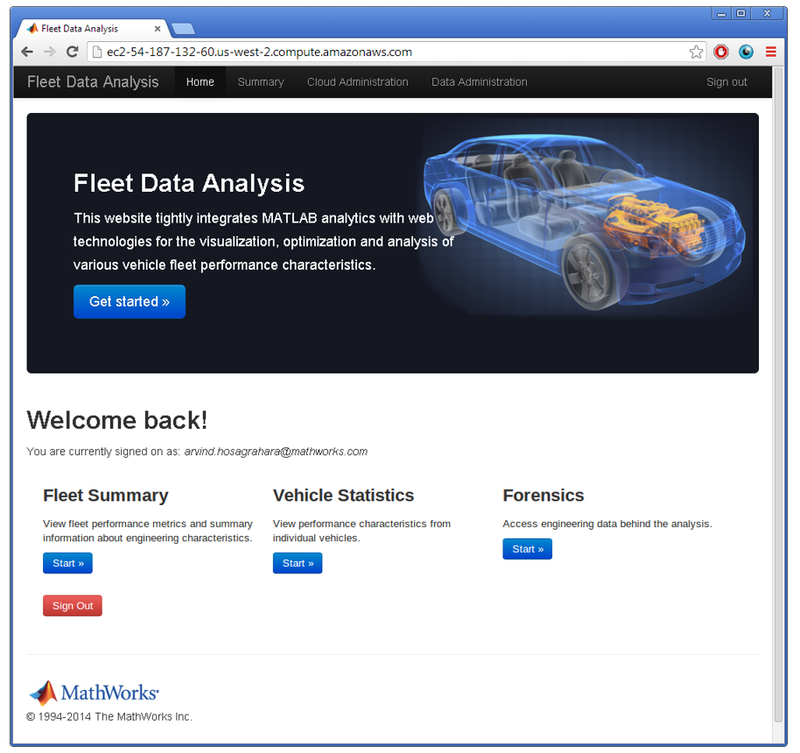
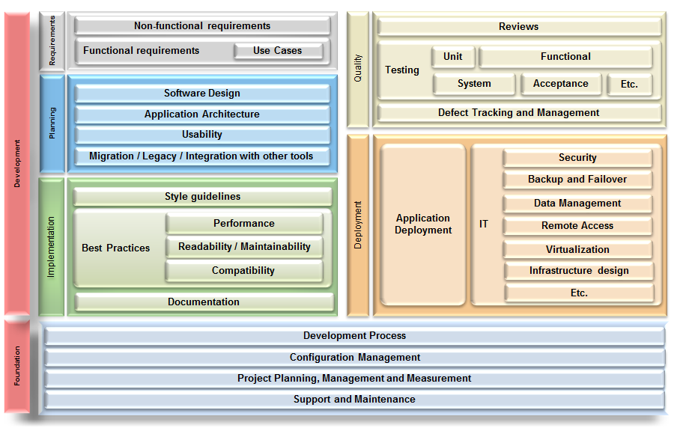
MathWorks Services
Consulting
Integration
Data analysis/visualization
Unify workflows, models, data
Training
Classroom, online, on-site
Data Processing, Visualization, Deployment, Parallel Computing
www.mathworks.com/services/consulting/
www.mathworks.com/services/training/
Notes:
קורס מתקדם
Utilizing development tools
• Verifying application behavior
• Creating robust applications
• Structuring code
• Structuring data
• Managing data efficiently
• Creating a toolbox

